Slide 1
Xiangqi
Chinese Chess
Author: Cuong Duc Do Yongzhao Zhang

Slide 2
History
Xiangqi (Chinese: 象棋; pinyin: xiàngqí), also called Chinese chess, is a strategy board game for two players. It is one of the most popular board games in China, and is in the same family as Western (or international) chess, Indian chess. Besides China, xiangqi (cờ tướng) is also a popular pastime in Vietnam.
The game represents a battle between two armies, with the object of capturing the enemy's general (king).

Slide 3
Rules
General can only move one step in the palace and two generals may not face each other along.The advisors start on either side of the general. They move and capture one point diagonally and may not leave the palace, which confines them to five points on the board.Elephants are located next to the advisors. These pieces move and capture exactly two points diagonally and may not jump over intervening pieces; the move is described as being like the character ‘田’. If an elephant cannot move due to a diagonally adjacent piece, it is known as "blocking the elephant's eye".Cannon must jump to capture,a rule prohibiting the generals from facing each other directly; A horse moves and captures one point and then one point diagonally away from its former position, a move which is traditionally described as being like the character “日”.

Slide 4
Rules
The chariot moves and captures any distance, but may not jump over intervening pieces.Each side starts with five soldiers. Soldiers begin the game located on every other point one row back from the edge of the river. They move and capture by advancing one point. Once they have crossed the river, they may also move and capture one point horizontally. Soldiers cannot move backward. Areas on the board called the river and palace, which restrict the movement of some pieces (but enhance that of others); and placement of the pieces on the intersections of the board lines, rather than within the squares.
The two players' pieces are usually colored red and black.Red move first step.

Slide 5
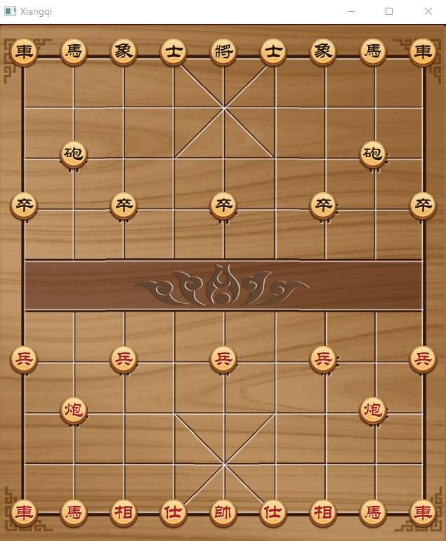
UI

Slide 6
Features
Login system
Player Info
Player vs Player
Player vs Computer (AI)
GUI with sound effects

Slide 7
Algorithms
MiniMax
Alpha Beta Pruning
Improve evaluation: value, position, mobility, control and threat
PVS (Principal Variation Search)
Heuristic History
Transposition Table

Slide 8
Technologies
JavaFX components
JavaFX Animation
JavaFX Media
JDBC (MariaDB)

Slide 9
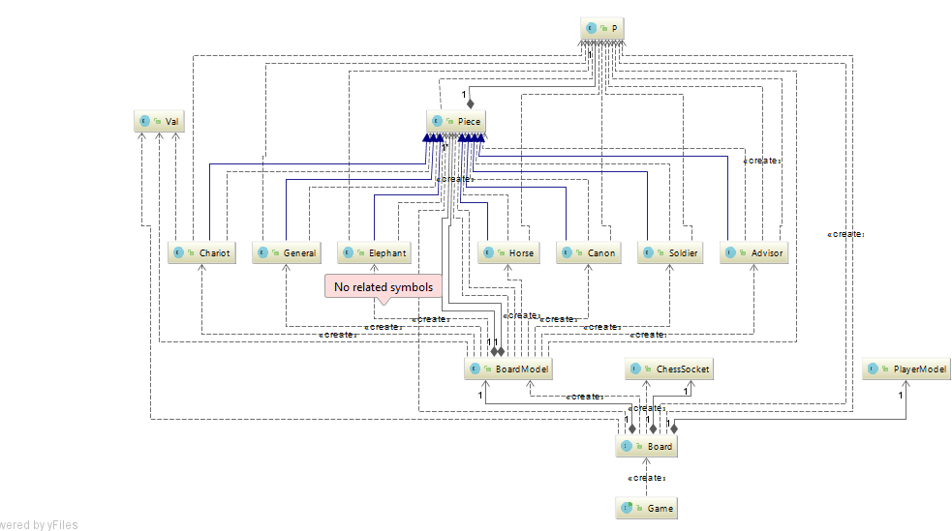
Class

Slide 10
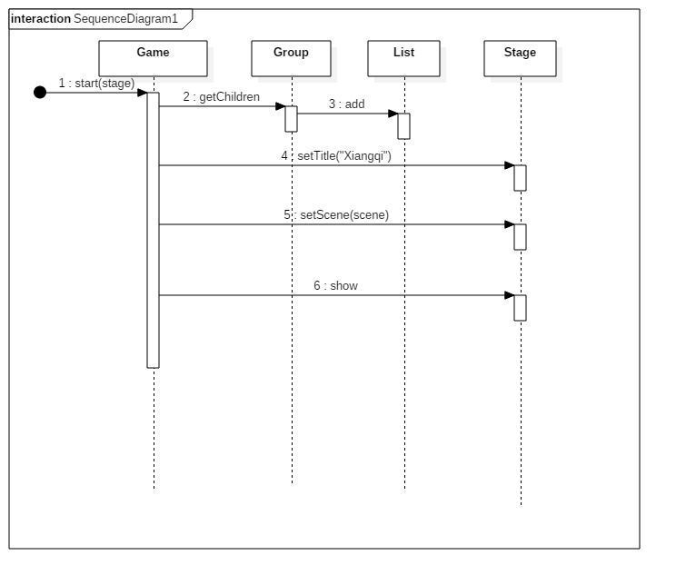
Sequence diagram

Slide 11
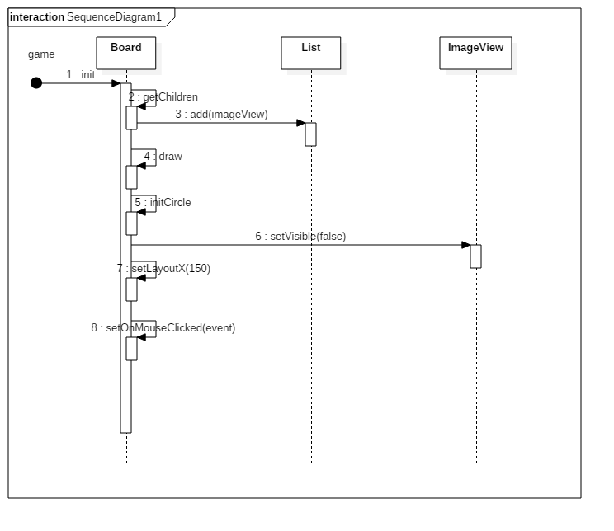
Sequence diagram

Slide 12
Thank You

